Slide 1

LSTM AutoEncoder & Feature Engineering For Small Assets Price Prediction
Group8: Zeyi Chen, Jiahao Zhang, Zikun Ye, Hongyang Lu

Slide 2

Agenda
Project Introduction& Data Collect
Feature Engineering
LSTM AutoEncoder
Result & Future development
Notes:
Due to the nonlinear nature and high dimensionality of stock market data, traditional approaches to stock prediction, such as LSTM, have become outdated. A recent advancement in the market is the introduction of the LSTM autoencoder, a deep learning model specifically designed to handle these challenges effectively. This new model offers promising capabilities for improving stock market forecasting accuracy and is worth exploring further.

Slide 3

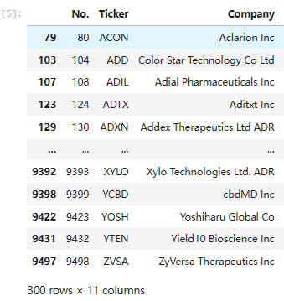
2. Data collect
America total stock
Yahoo finance API (yahooquery)
2022/5/1 - 2024/5/1 Daily data
9502
Exclude ETF
Individual company
6010
数据不足
技术不足
Small asset
Market capitalization percentile is 0.05
Small volatility
300
Notes:
Our findings from the analysis of stock market data are obtained from the Yahoo Finance API, covering the period from May 1, 2022, to May 1, 2024. Our dataset includes daily data for a total of 9502 stocks listed in the US market.
we discovered that among these stocks, there are 6010 individual company stocks after excluding ETFs, however, this vast number of stocks might not be ideal for our analysis.
In our analysis, we've condensed our stock data to focus on "small assets," which represent the bottom 5th percentile in terms of market capitalization. This subgroup consists of 300 stocks.

Slide 4
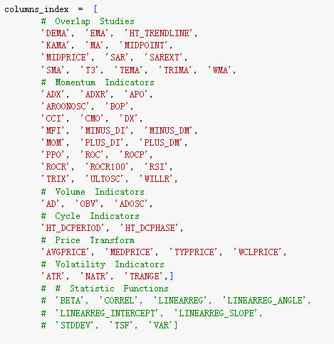
2. Feature Creation& Dimensionality Reduction
The stock market is complex, simply based on opening high and closing low does not reflect enough factors.
Feature Creation
54 important indicators (technical indicators) +Fama five-factor (SMB, HML, RMW, CMA, Mkt-Rf)
Dimensionality Reduction
We imported, adjusted, standardized, formatted these indicator data.
PCA: Linear method. It tends to preserve the global structure of the data.
T-SNE: Non-linear method. T-SNE is more visually attractive and interpretable than PCA.
数据不足
技术不足
Fama, E. F., & French, K. R. (2015). A five-factor asset pricing model. Journal of financial economics, 116(1), 1-22.
Notes:
The reason for this is because although we have found data corresponding to stocks opening high and closing low within two years as a basis, stock predictions are very complicated, and opening high and closing low do not reflect enough factors. Therefore, we chose to combine important indicators in the market (technical indicators section) with the Fama five-factor model to increase accuracy. Finally, through the analysis of previous data and data collection, we generated 54 important indicators in the market as shown in the figure.
We then imported these indicator data and adjusted the time zone and symbol and data settings to prepare for standardization and dimensionality reduction. We then segment, standardize, organize, and format the data so that it can serve model learning and analysis. After making initial preparations, considering the complexity of the data we selected and in order to detect clustering and features in this set of data, we used T-SNE technology to perform dimensionality reduction to integrate the data into three components and create the corresponding Data Frame and generation factors. In fact, in this part we considered whether to use the PCA dimensionality reduction method, but considering that the PCA method is a linear algorithm. The stock market itself is not linear. At the same time, T-SNE is more visually attractive and interpretable than PCA.

Slide 5
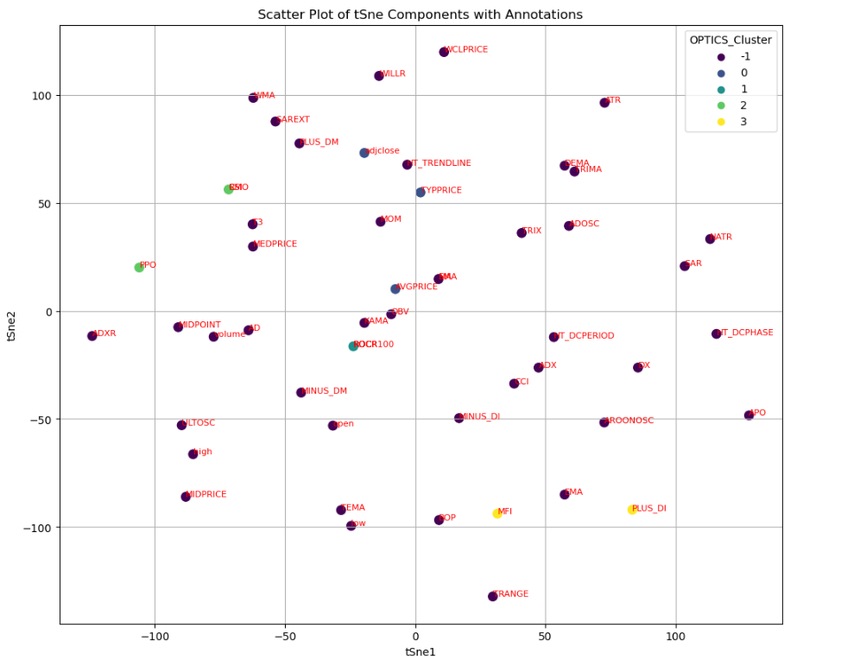
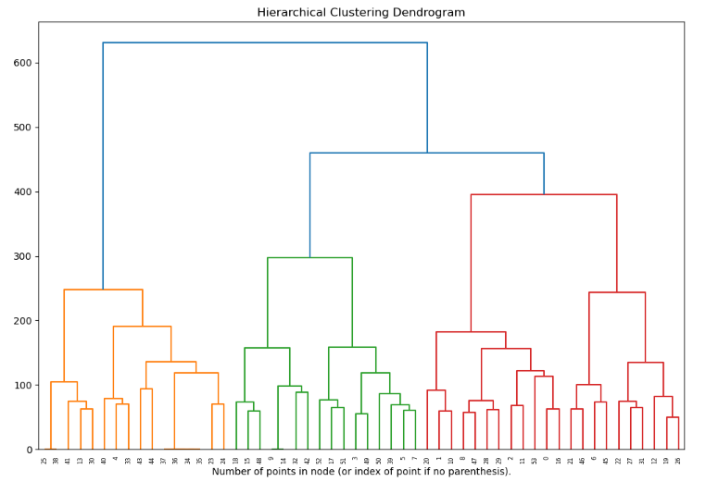
2. Feature Selection&Cluster
It is not that the more features, the more accurate predictions can be made.
K-mean
optimizing homogeneity within cluster by minimizing the variance to the cluster centroids
Difficult to apply to complex data sets due to sensitivity
Optics
A density-based clustering algorithm
Unable to determine center point
Hard to determine feature category
Hierarchical Clustering Dendrogram
Builds a tree of clusters by merging or splitting groups based on their distance or similarity.
The computing requirements are high and the output image is not intuitive enough.
Affinity Propagation Clustering
Notes:
After dimensionality reduction is completed, we test the optimal cluster size by measuring the goodness of fit via SSE. Subsequently, four models were established to carry out subsequent factor screening and clustering, namely K-mean, Optic, Hierarchical Clustering Dendrogram, and Affinity Propagation Clustering. This process is because it is not that the more features, the more accurate predictions can be made. It is predicted that more factors will generate noise and affect the model efficiency. Among them, the K-mean model optimizes the homogeneity within each cluster by minimizing the variance of the cluster centroid. However, this may not be true for complex data sets. The Optic model can identify clusters of different densities and automatically handle noise, but it cannot determine the center point ,and the feature category is difficult to judge. The Hierarchical Clustering Dendrogram splits the groups based on their distance similarity and builds a dendrogram. Compared with affinity propagation clustering, there are problems such as a large amount of calculation and the output image is not intuitive enough. Therefore, after comprehensive consideration, we selected the Affinity Propagation Clustering model for features selection and clustering.

Slide 6
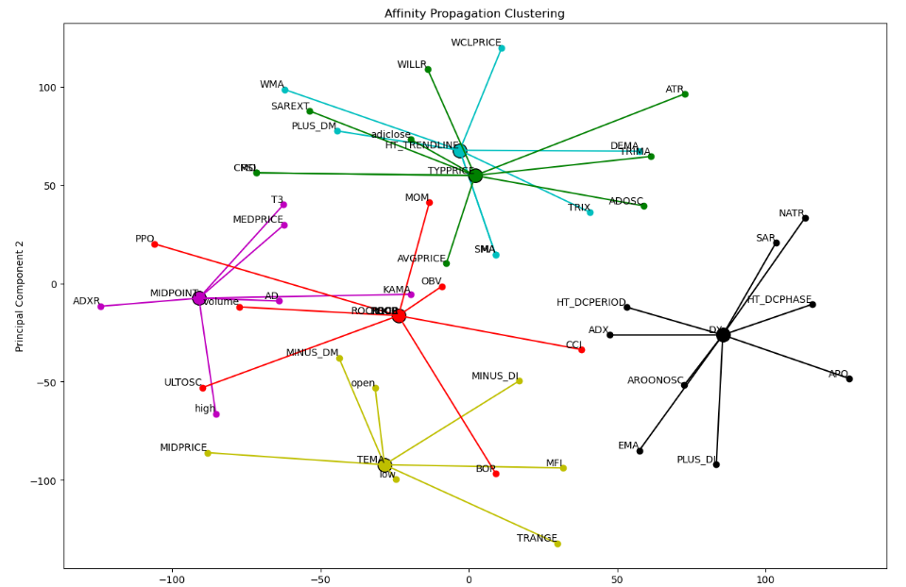
2. Affinity Propagation Clustering& Feature Conclusion
Affinity Propagation Clustering
Automatically determines the number of clusters based on the similarity between data points
Intuitively know the central feature
Feature Conclusion
Technical indicators (HT_TRENDLINE, MiDPOINT, TEMA, DX, ROCP, TYPPRICE) + Fama five-factor (SMB, HML, RMW, CMA, Mkt-Rf)
数据不足
技术不足
Notes:
Affinity Propagation Clustering mainly constructs the number of clusters based on the similarity between data points, that is, the distance between points represents the corresponding similarity. Based on the graph constructed by this model, we can intuitively find the center point and summarize it. In conclusion, the features we finally selected are Technical indicators (HT_TRENDLINE, MiDPOINT, TEMA, DX, ROCP, TYPPRICE) + Fama five-factor (SMB, HML, RMW, CMA, Mkt-Rf)

Slide 7
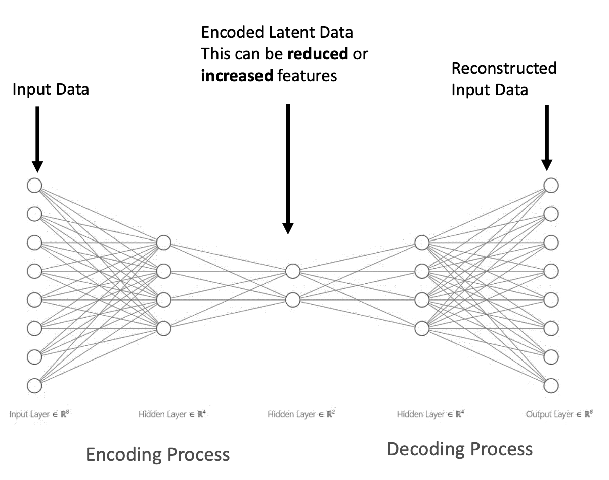
3. AutoEncoder Basic Introduction
Encoding high dimension information to low dimension
latent information
construct a model, that can decode the latent
information, and re-construct the original object
Finance：
Autoencoder is usually used for extracting the unobserved information in the financial data
We have 300 stocks’ 8 features in 2022.05-2024.05 ( 730 days), the data is a 730*300*8 matrix
数据不足
技术不足
Notes:
An autoencoder is an unsupervised learning algorithm that uses neural networks to encode and decode data. Compilers are mainly divided into encoders and decoders. The encoder helps us compress the input data into a smaller form. The decoder will help us reconstruct the original input data. The most important thing about this process is that it can help us capture the key information of the data that we cannot capture manually, and it can also help us remove unimportant information. According to the figure, our input and output data are of the same size, and the middle layer helps us find data features that cannot be found manually. The whole process is automated, we only need to enter the data (x), not the labels (y).
In the financial industry, autoencoders are used to extract factors in data that are not observed by humans. For example, in the stock market, autoencoders can help us identify potential factors that may affect stock prices but are not easily observed directly. Taking our specific dataset as an example, we have 8 features from 300 stocks, spanning 730 days from May 2022 to May 2024. These data form a 730×300×8 three-dimensional matrix. By applying autoencoders, we can try to understand the deep dynamics behind these stock characteristics and make more accurate investment decisions.

Slide 8
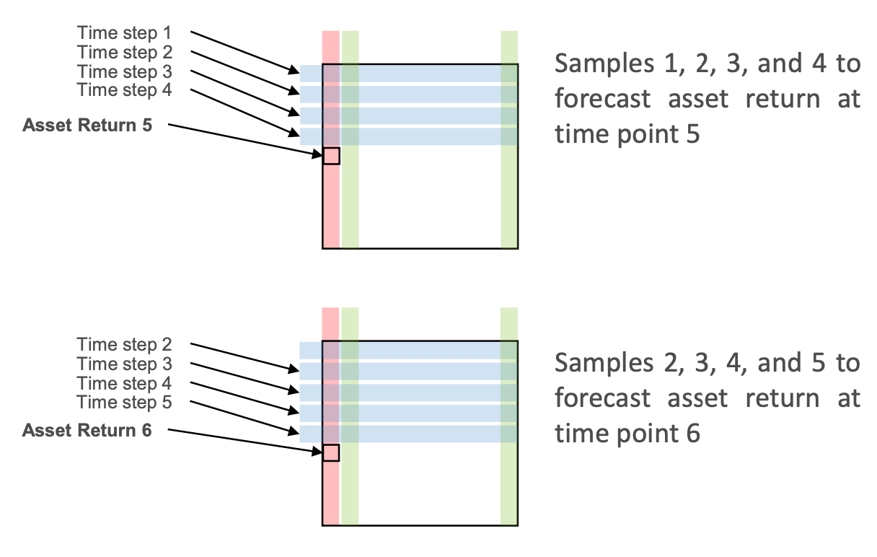
3. Simple LSTM vs LSTM AutoEncoder
Model architecture
Input layer: Match the dimensions of the input data.
LSTM layer: Two layers of LSTM. The first layer has 128 units and the second layer has 32 units. Both contain 50% Dropout to prevent over-fitting.
Output layer: a fully connected layer that outputs prediction results.
Training strategy
Loss function: Use mean square error (MSE), suitable for regression problems.
Optimizer: Use the Adam optimizer, which is a highly efficient method of automatically adjusting the learning rate.
Early stopping technology: Set early stopping to avoid overfitting during the training process, monitor the loss of the validation set, and stop training if there is no significant improvement for 6 consecutive cycles.
Dataset details
Number of samples: The dataset contains a total of 4 samples (sliding window).
Time step per sample: Each training sample contains 1 time step.
Number of features per time step: Each time step contains 8 features
Notes:
In this process, we used TensorFlow and Keras, two powerful deep learning libraries. For efficient model training and validation, we first split the dataset into training and test sets chronologically. We use 20% of the total days' data as the test set. In terms of data, we use the sliding window method to process time series data. We use the data from the previous four days as input features to predict the stock return on the fifth day. This approach helps us capture patterns and trends in time series data. In the process of building the model, we chose TensorFlow as the back-end framework and used the Keras API provided by it to define and train our LSTM network.
Model architecture
Input layer: Match the dimensions of the input data.
LSTM layer: Two layers of LSTM. The first layer has 128 units and the second layer has 32 units. Both contain 50% Dropout to prevent over-fitting.
Output layer: a fully connected layer that outputs prediction results.
Training strategy
Loss function: Use mean square error (MSE), suitable for regression problems.
Optimizer: Use the Adam optimizer, which is a highly efficient method of automatically adjusting the learning rate.
Early stopping technology: Set early stopping to avoid overfitting during the training process, monitor the loss of the validation set, and stop training if there is no significant improvement for 6 consecutive cycles.

Slide 9
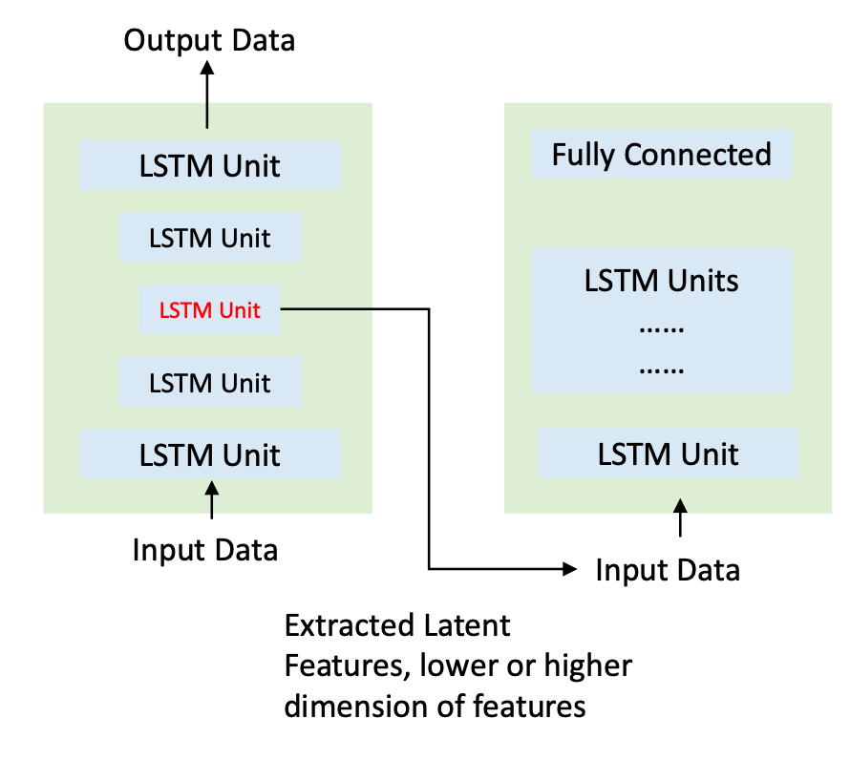
3. Simple LSTM vs LSTM AutoEncoder
LSTM (Long Short-Term Memory)
Suited for time series data
Uses memory cells to store information
Good for applications like speech recognition, language modeling
LSTM AutoEncoder
Combines LSTM with autoencoding for feature extraction
Efficient in data compression and noise reduction
Ideal for anomaly detection, data denoising
Autoencoder + LSTM
Extract latent information from the features
Combine the latent information with the original features and train a separated LSTM for forecasting the asset return
Kelly, B. T., S. Pruitt, and Y. Su (2019). Characteristics are covariances: A unified model of risk and return. Journal of Financial Economics 134(3), 501 – 524.
Gu, S., B. T. Kelly, and D. Xiu (2021). Autoencoder asset pricing models. Journal of Econometrics 222(1), 429 – 450
Notes:
In this project we combine long short-term memory network (LSTM) and autoencoder techniques to improve the accuracy of financial asset return predictions. Our method effectively extracts features and performs data compression and noise reduction through two-stage LSTM processing, coupled with an intermediate autoencoder.
First we used LSTM, which is very suitable for processing time series data. Our data input goes into a two-layer LSTM layer to capture the relationship and dynamic changes in the sequence. We then pass the output obtained from the first LSTM model to the autoencoder, allowing the autoencoder to extract key information that has not been discovered and reduce interference data in the data. After extracting the latent features and combining them with the original features, we then transfer all the data into another LSTM model for final prediction. This can improve the prediction accuracy of the model and help us analyze changes in the stock market more accurately.

Slide 10
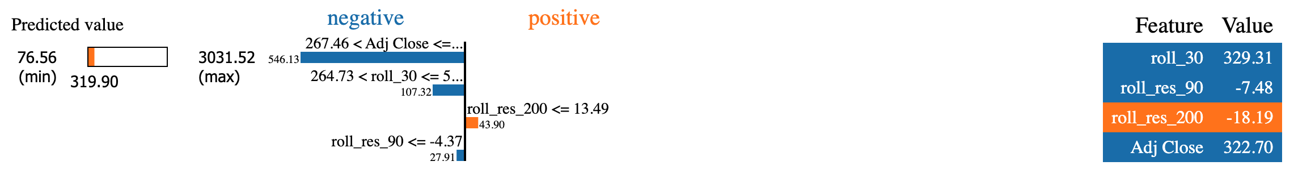
4. Result
Improvement Strategies:
Enhanced Model Tuning: Utilize a Pipeline approach for systematic tuning of hyperparameters, activation functions, and loss functions. Expand the neural network architecture by adding additional layers and units to improve learning capacity.
2.Individual Company Analysis: Transition from a single model predicting outcomes for all companies to individual models for each company.
3.Feature Interpretability: Implement LIME for enhanced transparency.
 | LSTM | Autoencoder+LSTM
MSE | 0.0539 | 0.0552
R^2 | 0.05% | 2.72%
Analysis:
The Autoencoder + LSTM model demonstrates a slightly better prediction accuracy compared to the standalone LSTM model.
However, the standalone LSTM model exhibits greater stability in performance, as indicated by a lower variance in error.
Kelly, Bryan, and Dacheng Xiu. n.d. “Financial Machine Learning.”
Notes:
Model Comparison: LSTM vs. Autoencoder + LSTM
Performance Metrics:
MSE (Mean Squared Error):
LSTM: 0.0539
Autoencoder + LSTM: 0.0552
R² (Coefficient of Determination):
LSTM: 0.05%
Autoencoder + LSTM: 2.72%
Analysis:
The Autoencoder + LSTM model demonstrates a marginally better prediction accuracy compared to the standalone LSTM model, as evidenced by a higher R² value.
Conversely, the standalone LSTM model shows greater stability, indicated by a lower MSE, suggesting it may be more reliable under varying conditions.
Improvement Strategies:
Enhanced Model Tuning:
Systematic Hyperparameter Tuning: Utilize a pipeline approach to methodically adjust hyperparameters, activation functions, and loss functions. This systematic approach aims to refine the models to better capture the underlying patterns in the data.
Architecture Expansion: Increase the complexity of the neural network by adding more layers and units. This enhancement is intended to improve the model's capacity to learn from a broader set of features and interactions, potentially increasing its accuracy and generalizability.
Individual Company Analysis:
Model Specialization: Shift from a generic model that predicts outcomes across all companies to specialized models tailored for individual companies. This strategy is designed to account for unique characteristics and trends within each company, potentially improving predictive performance and relevance.
Feature Interpretability:
Implementation of LIME: Adopt Local Interpretable Model-agnostic Explanations (LIME) to increase the transparency of the model predictions. This tool helps in breaking down which features significantly impact the model's decisions, aiding in the understanding and trustworthiness of the model outputs. Enhancing feature interpretability is especially crucial when making financial decisions based on model predictions.
Conclusion: While the Autoencoder + LSTM model shows a slight edge in accuracy, its stability needs enhancement. The proposed strategies aim to optimize both models further, enhancing their predictive performance while ensuring robustness and interpretability. These improvements are essential for developing reliable and actionable insights in financial modeling.

Slide 11
4. Future Development
Model Selection Insights:
Time Series vs. Cross-Sectional Models:
Research indicates that the 𝑅2 values for time series models typically fall below 3%.
Utilizing cross-sectional models is recommended to achieve higher performance portfolio.
Factor Analysis:
Navigating the Factor Zoo:
Over the past two decades, thousands of factors have been proposed across academia and the financial industry.
Identifying effective factors is crucial for enhancing model accuracy and performance.
Importance of Factor Types:
Technical indicators represent time series features.
Five factors are identified as cross-sectional features.
Studies suggest that relative performance factors are more effective in achieving superior model performance.
Arnott, Robert D, Vitali Kalesnik, and Juhani T Linnainmaa. 2023. “Factor Momentum.” Edited by Tarun Ramadorai. The Review of Financial Studies 36 (8): 3034–70.
Feng, G., Giglio, S., & Xiu, D. (2020). Taming the factor zoo: A test of new factors. The Journal of Finance, 75(3), 1327-1370.
Notes:
Model Selection Insights: Time Series vs. Cross-Sectional Models
Comparative Performance:
Research shows that the 𝑅2R2 (coefficient of determination) values for time series models are typically below 0.3, indicating a relatively low percentage of variance in the target variable that is predictable from the features.
Recommendation: Utilize cross-sectional models, which have demonstrated the ability to achieve higher 𝑅2R2 values, thus providing more accurate and reliable predictions for portfolio performance. This approach aligns portfolios more closely with current market conditions by analyzing data across various assets at a single point in time.
Factor Analysis: Navigating the Factor Zoo
Extensive Range of Factors:
In the last two decades, the financial sector and academic researchers have proposed thousands of factors, creating a vast 'factor zoo'. The proliferation of these factors ranges from fundamental metrics like earnings yields to more complex constructs like sentiment indices.
Critical Task: The key challenge is to sift through this extensive array of factors and identify those that consistently contribute to predictive accuracy. This process involves rigorous testing and validation to ensure factors are not only statistically significant but also economically meaningful.
Importance of Factor Types:
Technical Indicators: These are time series based and include tools like moving averages and relative strength indicators. They are primarily used to forecast future price movements based on past patterns.
Cross-Sectional Factors: These involve variables like size, value, and momentum which are measured across different securities at the same point in time. Five key factors have been identified that significantly influence cross-sectional differences in returns.
Empirical Evidence: Various studies have pointed out that factors based on relative performance, such as momentum or relative valuation, tend to yield superior results in terms of enhancing portfolio returns and reducing risk.
Strategic Implementation:
Integrating Insights into Portfolio Management:
The insights from factor analysis should be integrated into the portfolio management process through a systematic approach that combines both historical data and real-time market conditions.
Continuous Evaluation: It's essential to continually reassess the relevance and effectiveness of chosen factors, as their impact can vary with changes in market dynamics and economic cycles.

Slide 12
Thanks for watching
Q & A
BIG DATA FINANCE

